Slide 1
Git & GitHub

Slide 2
Setting Up Git
git --version
git config --global
git config --global user.email "akshayvanil117@gmail.com"
git config --global core.editor
git config --global core.autocrlf true
git init project

Slide 3
git add .
git commit -m "Initial Commit"
git status //view changes
git restore --staged //restore or unstage
git diff //compare
git remote add origin https://github.com/akshay117/ustdemo.git
git push -u origin master

Slide 4
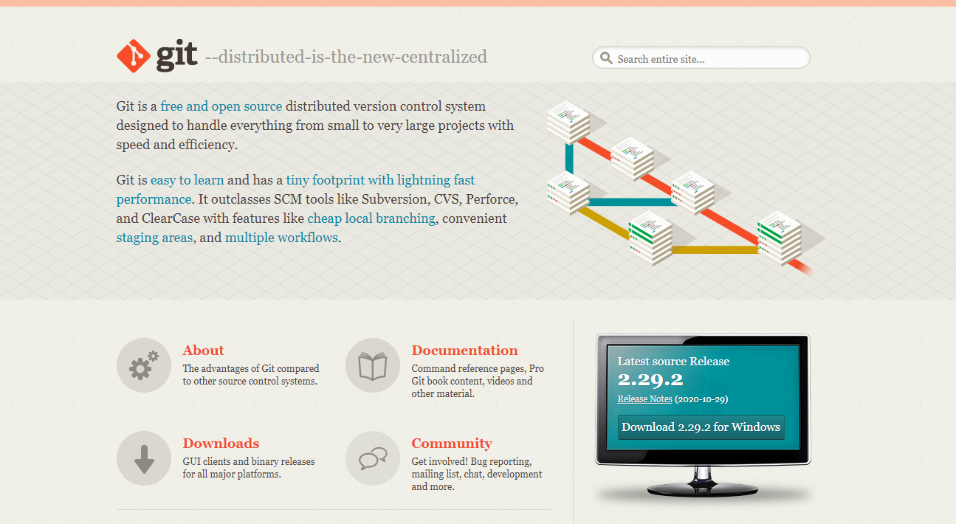
Git Download

Slide 5
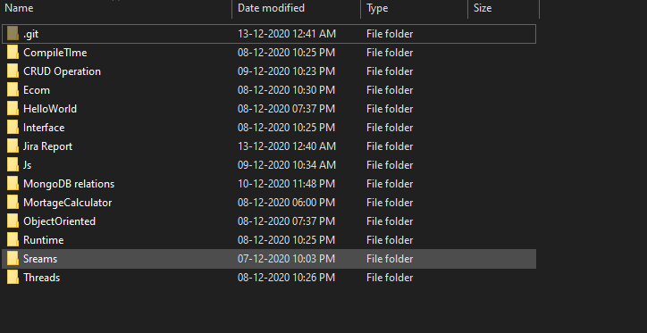
Initialised git folder on local filesystem.

Slide 6
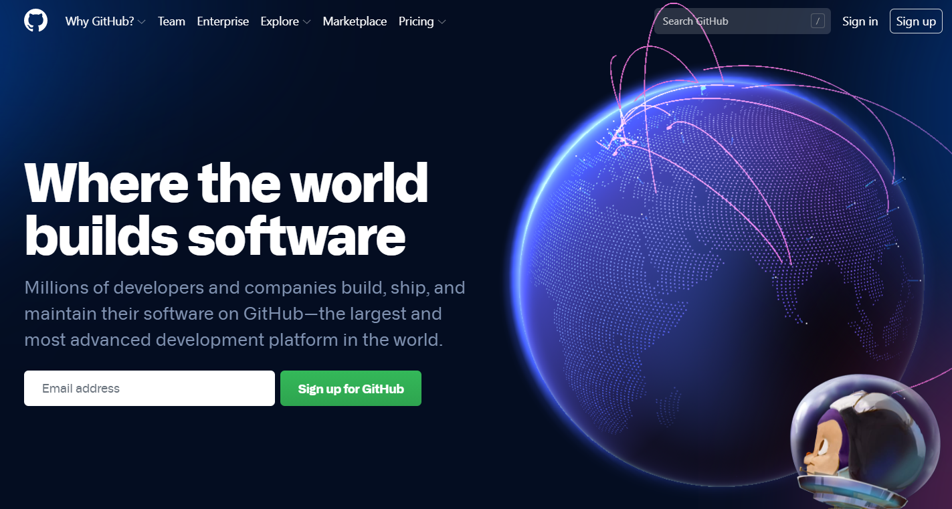
Github Sign Up

Slide 7
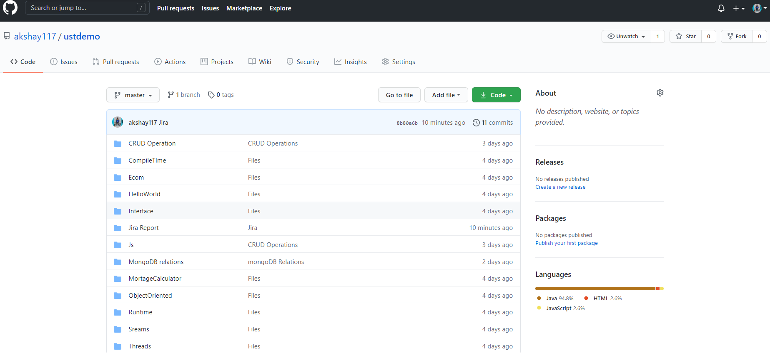
GitHub Repository

